Slide 1


ALUMNICONNECT
Team Name: AlgoForce
College: GL BAJAJ
Team Members:
Anjali Dubey(lead)
Vatsal Mittal
Harshit Chaudhary

Slide 2
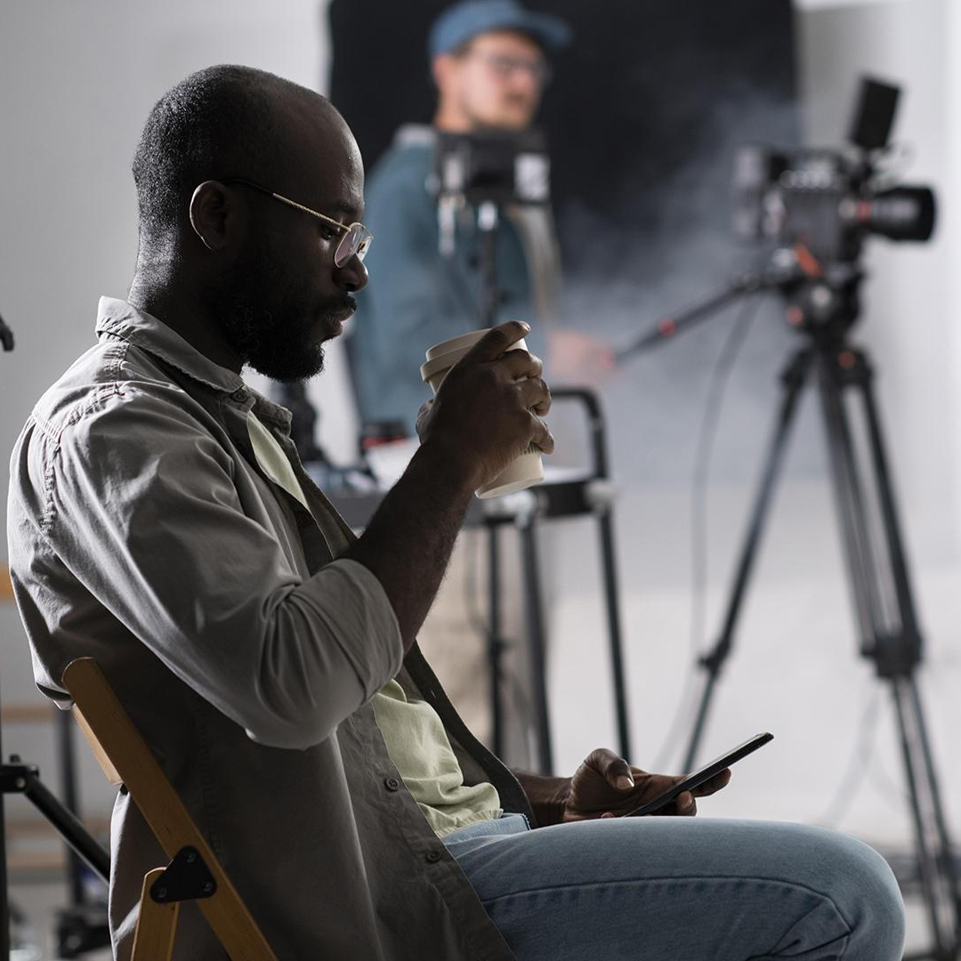
Problem statement
ID: PS-03
Organization: ITS
Problem: Colleges lose alumni connections post-graduation due to poor data and channels.
Need: A smart system to manage alumni, encourage engagement, and facilitate mentorship.

Slide 3

i
“Great institutions are built not only by faculty and students, but also by alumni who carry the legacy forward”
Showcases notable alumniOur Idea:
Add AI-based suggestions for mentorship matches and skill-based networking
Alumniconnect is a web-based alumni platform that:
Allows alumni to register and update profiles
Facilitates mentorship matching with students
Enables event announcements and interactions
.

Slide 4

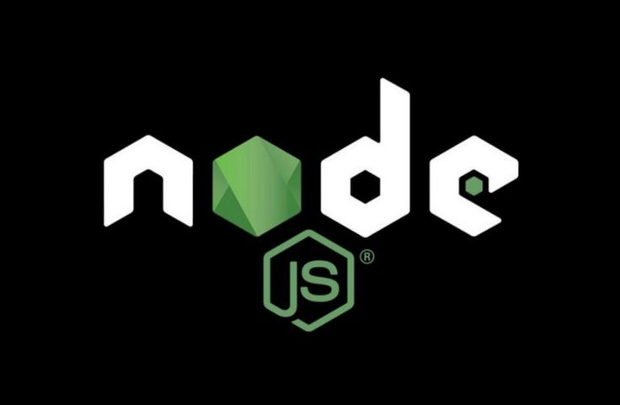


System Architecture
FlowFrontend: React.js
Backend: Node.js + Express
Database: MongoDB
AI Matching : Python(flask) or Node ML Libs
Frontend
Backend
Backend
Database

Slide 5
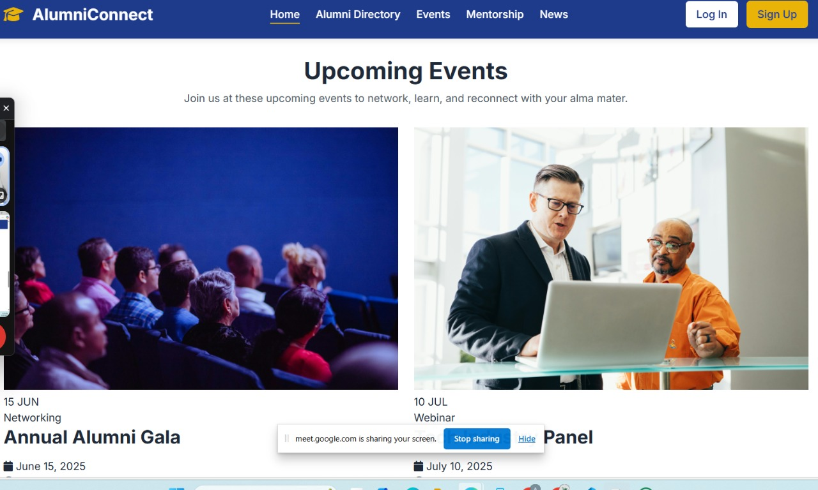
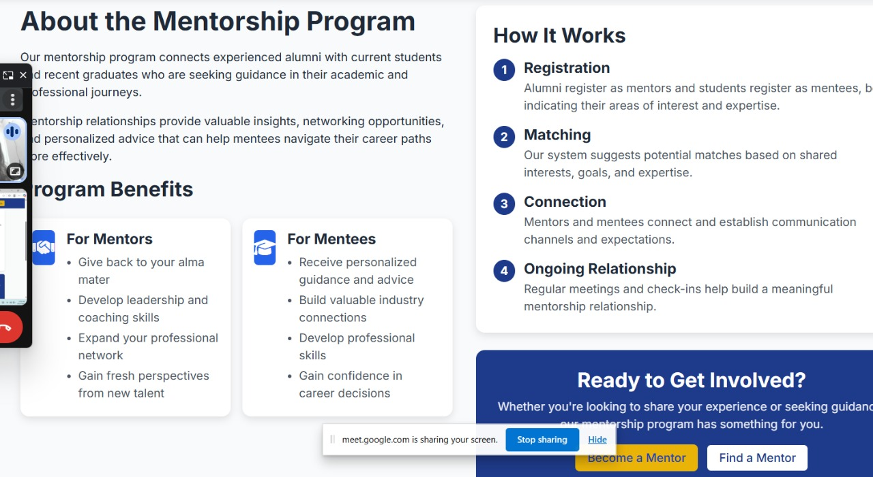
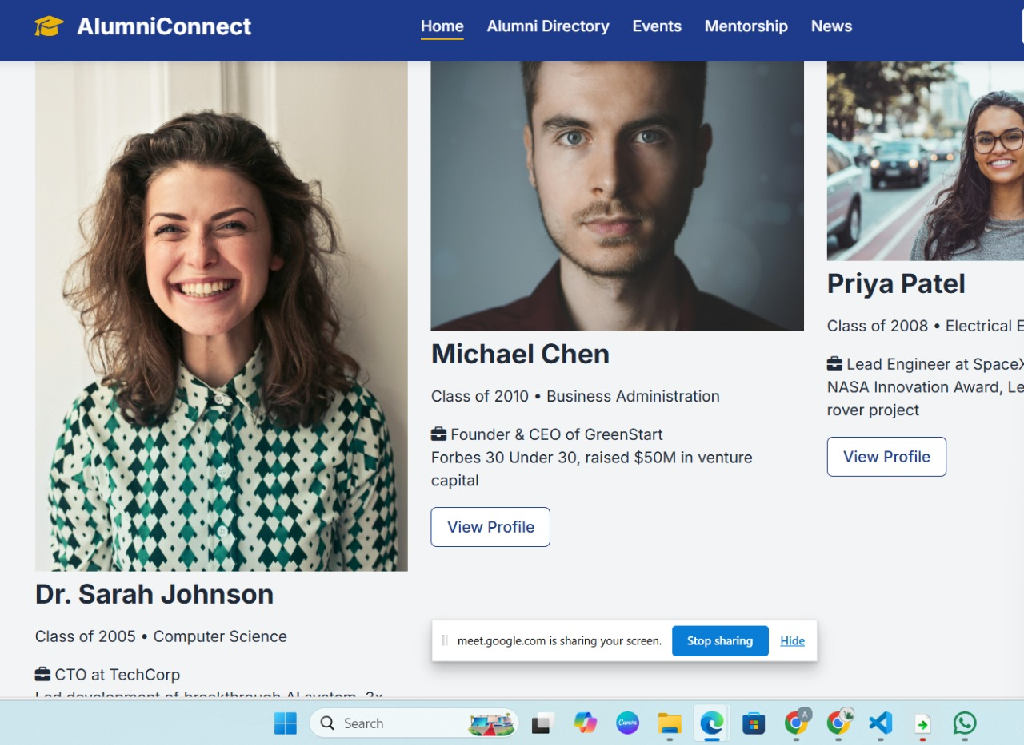
Features:
User Authentication
Profile Management
Event Calendar
AI Matchmaking Engine

Slide 6
Features & Implementation
Alumni Registration/Login
Editable Profile Dashboard
Search & Connect (Mentorship)Event Notifications
Admin Panel for Management
Hackathon Focus: Core modules, AI-based mentor matching, basic UI

Slide 7
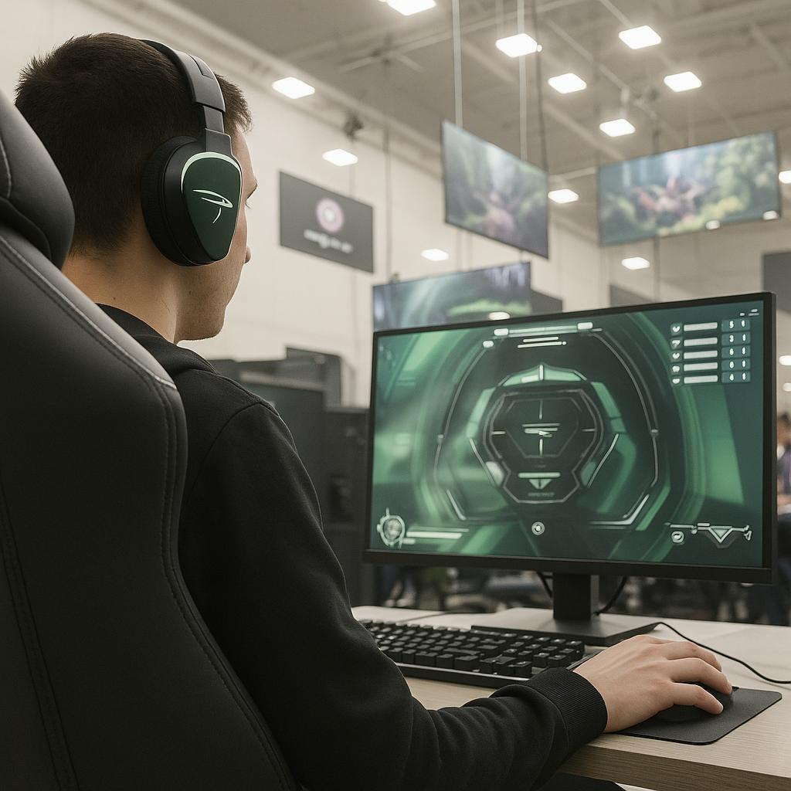

Innovation & Uniqueness
AI-powered mentor suggestions
Skill & interest-based alumni discovery
Scalable structure to include job boards or project collaborations
Gamification for alumni engagement (badges, leaderboards)

Slide 8


Challenges & Future Scope
Challenges :Data security & privacy
Scalable user handling
Mitigation :Role-based access, secure login, scalable hosting
Future Scope:Mobile app version
Integration with LinkedIn
Donation & fundraiser modules

Slide 9
THANKING YOU

